Slide 1

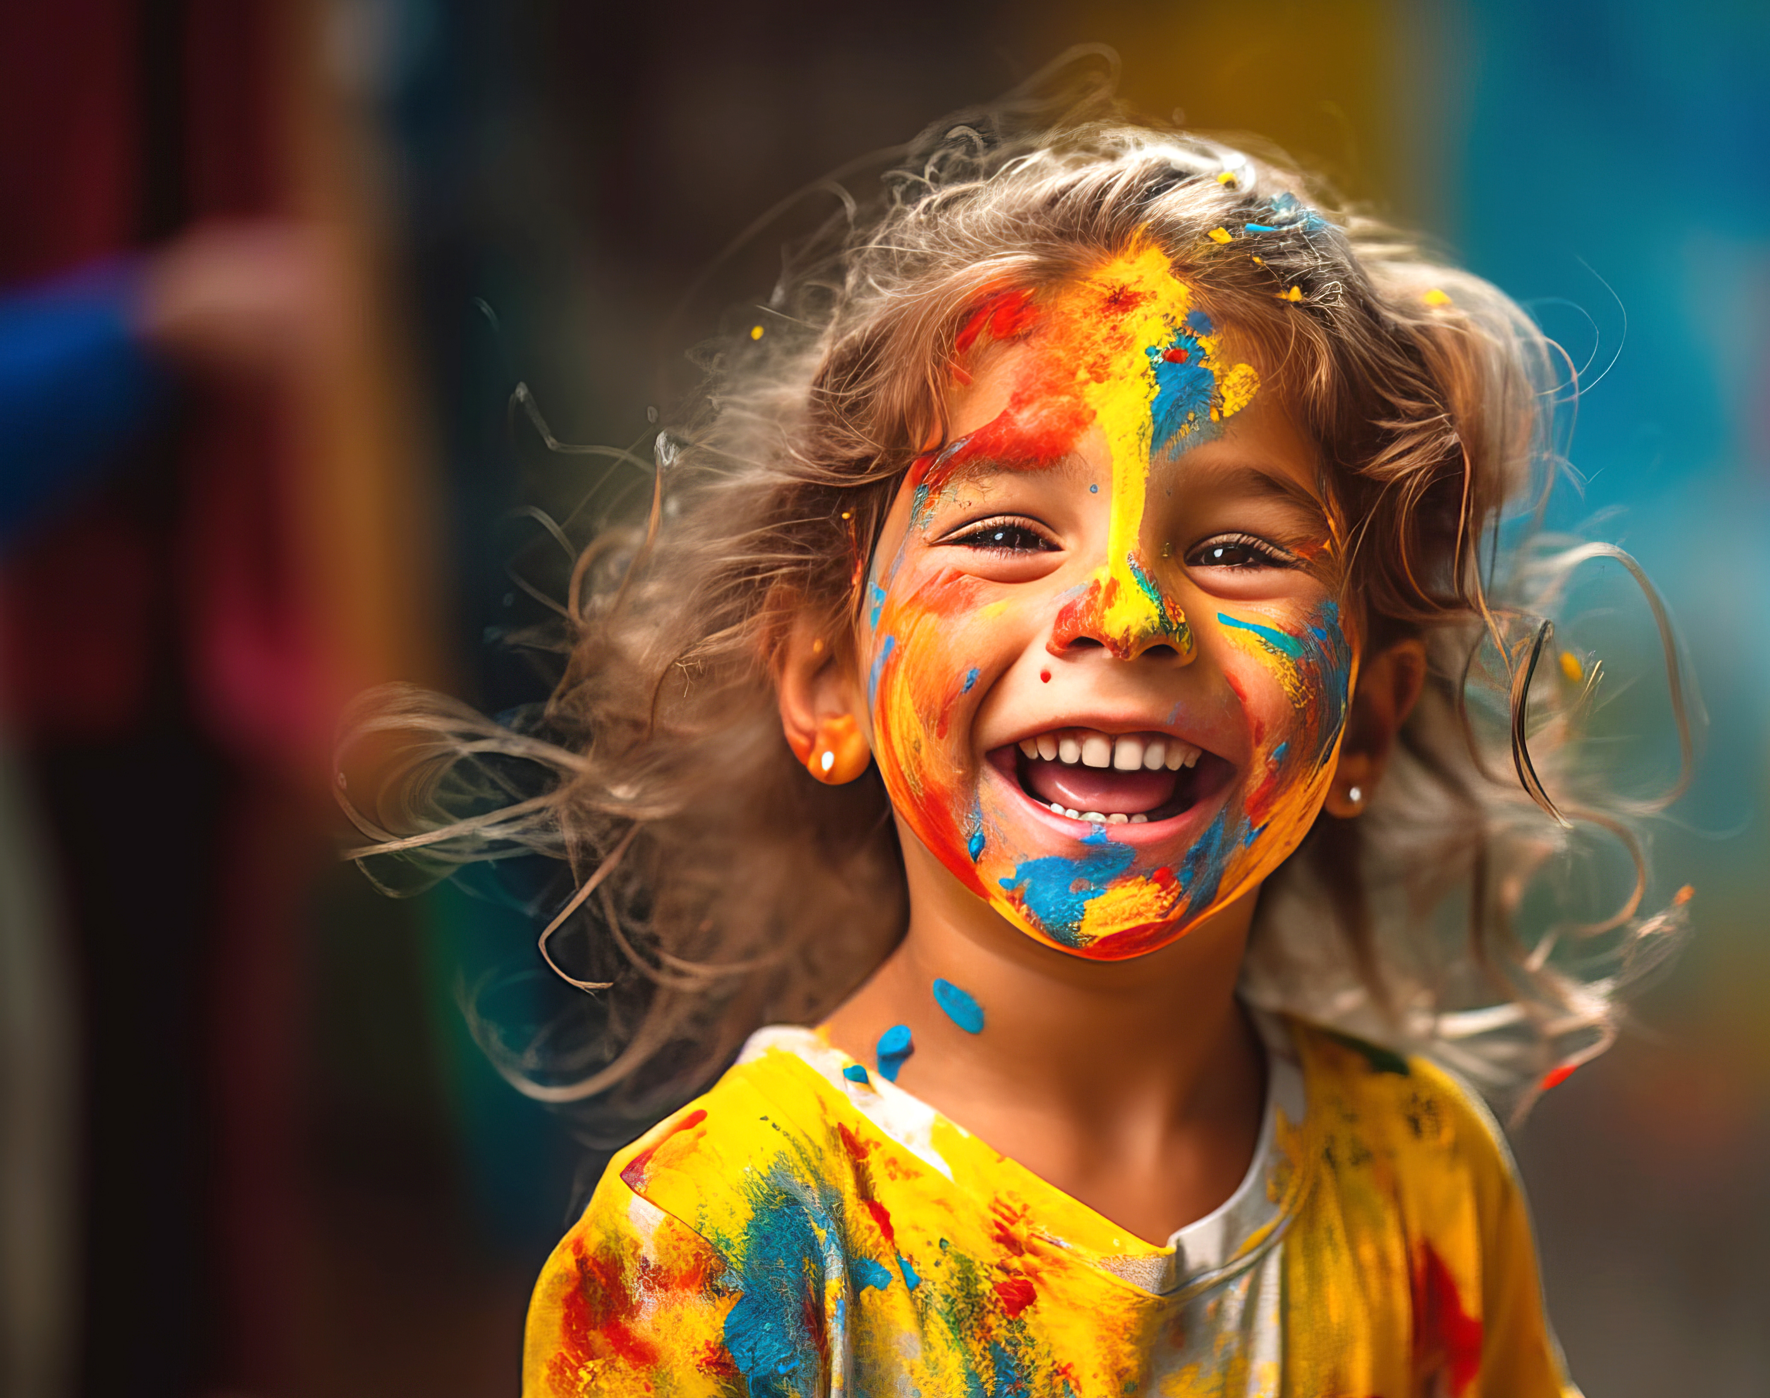

Adult and children colour selections for emotion terms: The importance of chroma and hue
Déborah Epicoco*, Domicele Jonauskaite & Christine Mohr
Institute of Psychology, University of Lausanne, Switzerland
*Deborah.Epicoco@unil.ch
Notes:
Presenting myself and what I will talk about

Slide 2
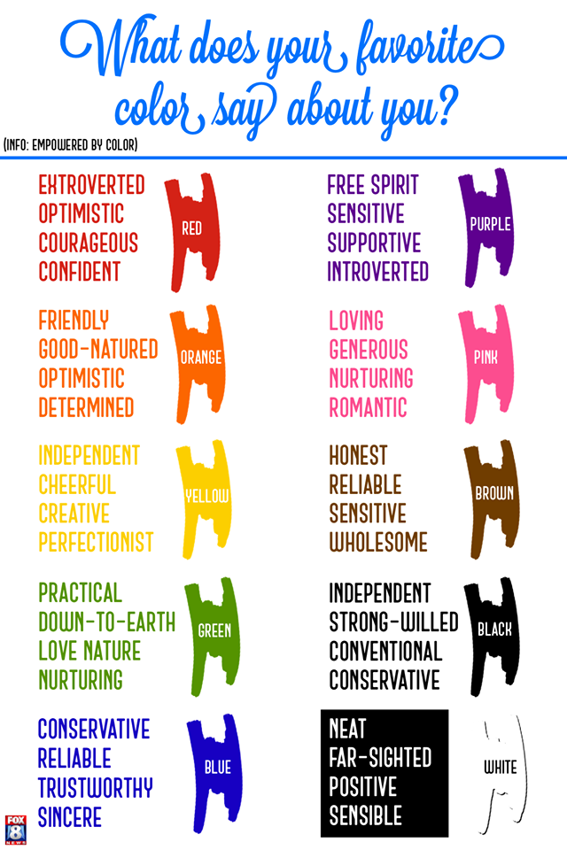
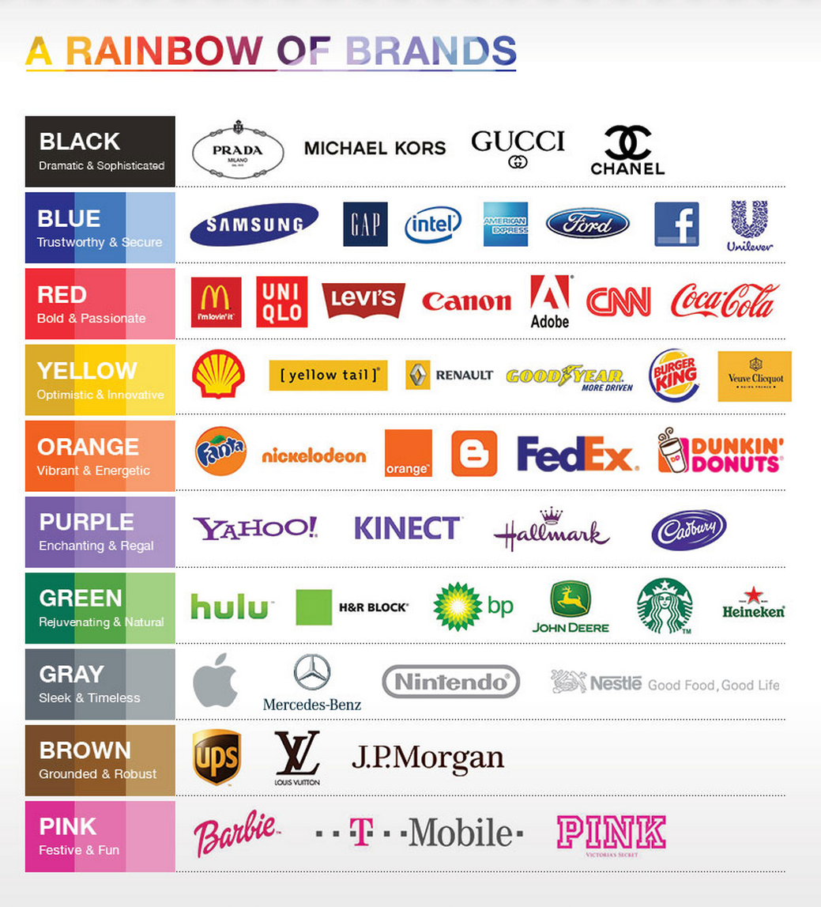
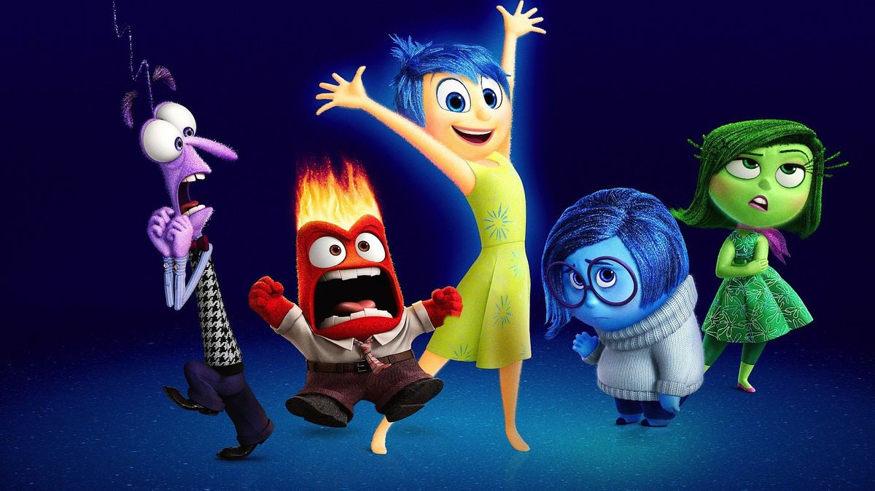
INTRODUCTION
Adams & Osgood (1973); Jonauskaite et al. (2019, 2020a); Jonauskaite, Epicoco et al. (in revision); Mohr et al. (2018); Valdez & Mehrabian (1994)
Notes:
Natural process to want to relate things to colours – more and more we can see different blog posts and articles about how colour are supposed to have an effect on our affective process or even or thinking process, such as
(1) – Related to marketing = i.e., grey colour is supposed to represent a timeless concept while, red is supposed to give energy and be passionate
(2) – Related to our personalities = i.e., favourite colour is black you are an independent but conventional person and if it is purple, you are sensitive and somewhat introverted. Can tell you, purple is my favourite and not a lot of people will describe me as introverted.
Thus, not surprising to think that it can also be related to our emotional process – (3) – A great example, that might speak to lots of people is also the movie... Inside/Out, where all the persona representing emotions are in a specific colour. It is interesting because it relates to some points in the literature, that tells us colour do carry affective meaning in the following sense
Light colors tend to be related to more positive emotions, such as love, joy or pleasure (see here joy in the middle)
Darker colors will be seen more negatively, such as sadness and anger (see here anger, it is a dark red but very bright since anger is a high arousal emotion)
I think I can already give you a spoiler by saying that the literature tells us some colour-emotion associations are particularly well documented and tend to be found more often, despite different cultural background. So what are the specific colour-emotions associations we tend to find?

Slide 3
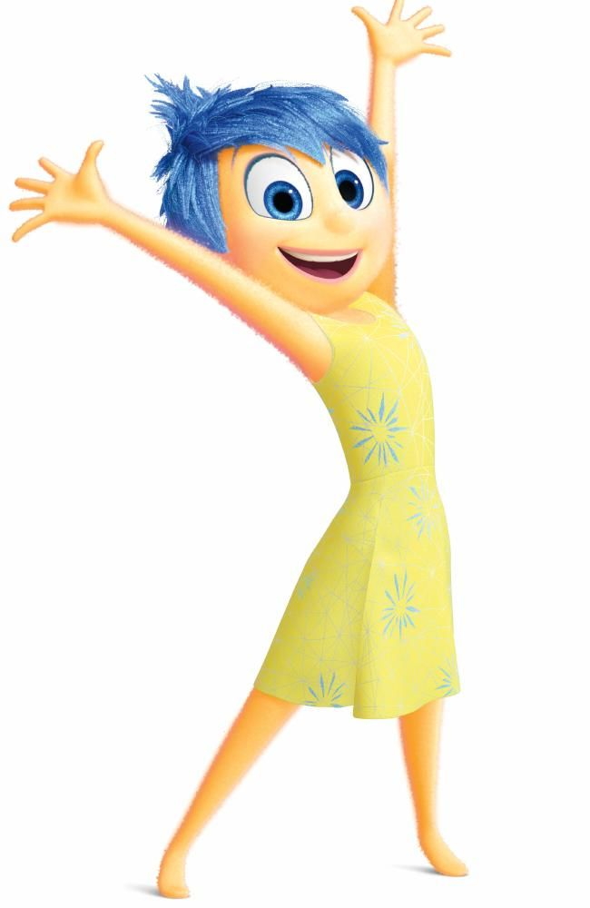

COLOUR-EMOTION ASSOCIATIONS: WHAT DO WE KNOW?
Global Colour-Emotion Association Pattern
Colours carry affective meaning:
30 nations (n = 4,598)
Average nation-to-global similarity coefficient, r = .88
Jonauskaite et al. (2020a)
Notes:
We asked people from 30 nations:
What emotion(s) do they associate with a colour term (i.e., a colour name written in black ink)
We found an average similarity of .88, which means that out of those 30 nations, the majority of pps tend to have the same colour-emotions associations.
Of course, some association are stronger than others! How do I know this here?
The matrix here shows the pattern of colour-emotions associations for 12 colours terms and 20 emotions terms → the redder the square, the more participants associated the emotion with said colour.
In general, negative emotions are more strongly associated to a specific colours while in the positive emotions, we can see more mouvement, meaning participants chose several emotions with the same colours.
But! We do have strong associations such as yellow-joy; red-anger or red-love (show we can have one colour for both positive/negative emotions)
Now, we can think, that it might be an effect of age, since most of the pps here are between 18 and 30 years old. Cross-sectionally, generations lived through different times and challenges, some of them potentially very affective. So, we could wonder, if we were to look more across the age spectrum, if the associations would be different ?

Slide 4



COLOUR-EMOTION ASSOCIATIONS: WHAT DO WE KNOW?
Jonauskaite, Epicoco et al. (in revision)
Notes:
To do so, we compared to our eldest sample (65-88 y.old) three younger ones, from 14 different nations, applying the exact same design as presented above. The samples are
1. 18-30 y.old → r = .89
2. 30-50 y.old → r = .94
3. 50-65 y.old → r = .96
So, if we were to roughly translate our correlation, it would be that 96% of our elder sample have the same colour-emotion associations. You might think you did not see any difference, it’s because they are marginal. In all three, we replicated a high-similarity in colour-emotions associations, with the highest correlation being the last one, where the groups are closer in age.
We can say for all the age groups that negative emotions are more one-on-one for both groups, meaning our participants usually picked one emotion per colour. They are also more related to darker and achromatic colours such as black and grey.
Positive emotions are more scattered, they are less intensely associated with one emotion, meaning pps tend to pick more than one emotion, and so, we can see it well with yellow and green. But we still find the big colour-emotions associations, such as red-love; yellow-joy.
Here we can say with some certainty:
Once we reach adulthood, age does not seem to matter when it comes to colour-emotion associations. Despite a few differences, the associations are well-known and shared
Raises the question of the importance of perception: Here, we do find a strong evidence that conceptual knowledge of colours seem sufficient to create the pairings, at least for adults. So what if we use colour patches instead of colour terms?

Slide 5
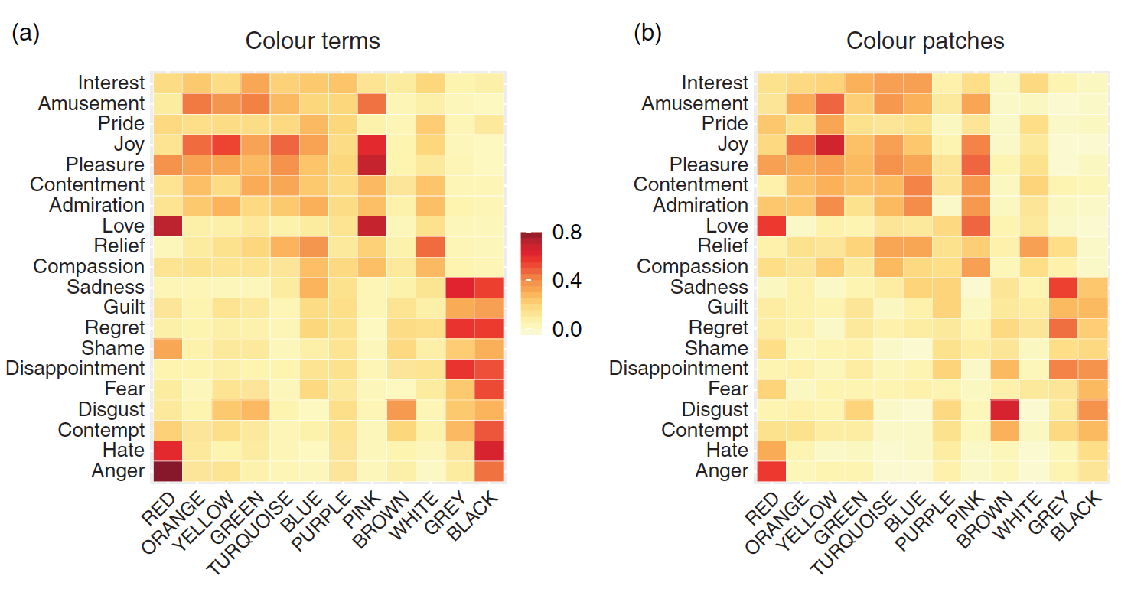
COLOUR-EMOTION ASSOCIATIONS: WHAT DO WE KNOW?
r = .82
Jonauskaite et al. (2020b)
Notes:
By colour patch, we mean we presented to participants the best example of a colour term and ask them to pick the best emotion(s) for this patch. This was done between-subject in Swiss young adults, so the associations are spontaneous.
We can see that young adults associated similar emotions when given colour terms or colour patches, with an average coefficient of .82 = so those participants associated the same emotion whether they saw a patch or a term. BUT we can see that patches are in general lighter than the terms, which mean participants were more likely to systematically associate anger with red when they saw a term, rather than the patch. In this study, the only significant difference between the patches and the terms was the negative emotion associated to black, it was again, stronger with the terms.
Apart from the difference for black, it seems these results would indicate that not only colour-emotion association are a well-established concepts whether you show a term or a patch. Also means that conceptual knowledge is sufficient for such affective meanings to occur, at least once conceptual knowledge is well established since we have here, only studied adults.
Raises the question of the importance of perception for those pairings: if we were to ask children to do the same pairing task, would the same pattern of colour-emotion pairings still emerge, therefore meaning the conceptual knowledge of colour-emotion associations is already acquired?

Slide 6

PARTICIPANTS
Compared 20 emotion-colour pairings in three non-colour-blind Swiss samples:
6-7 years old children (n = 33, 12 females)
11-12 years old children (n = 30, 14 females)
18-32 years old adults (n = 63, 51 females)
How well is conceptual knowledge established for colour-emotion pairings,
when comparing two groups of children and adults?
Notes:
This is what we did here! We compared 20 emotion-colours in three different samples, to see if the conceptual knowledge is as well establish in two children groups of different ages, than the adults.

Slide 7
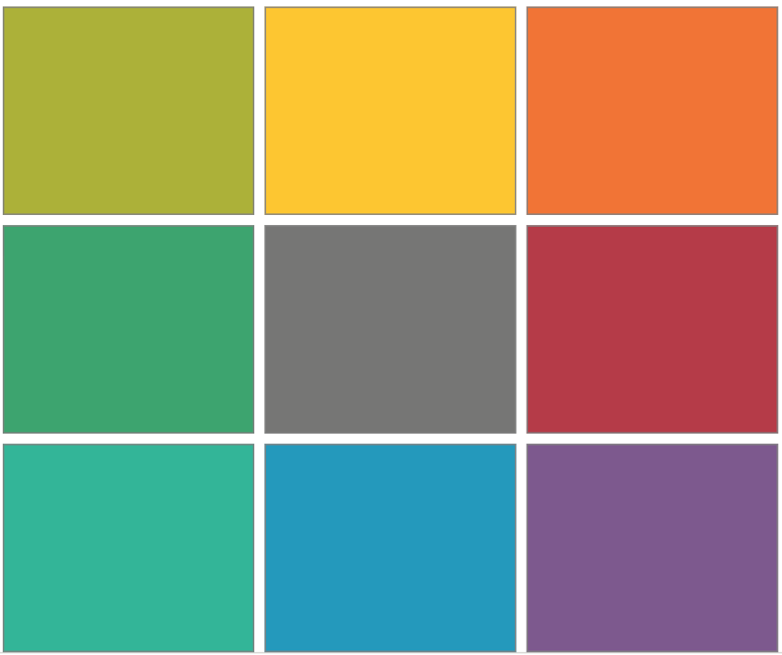
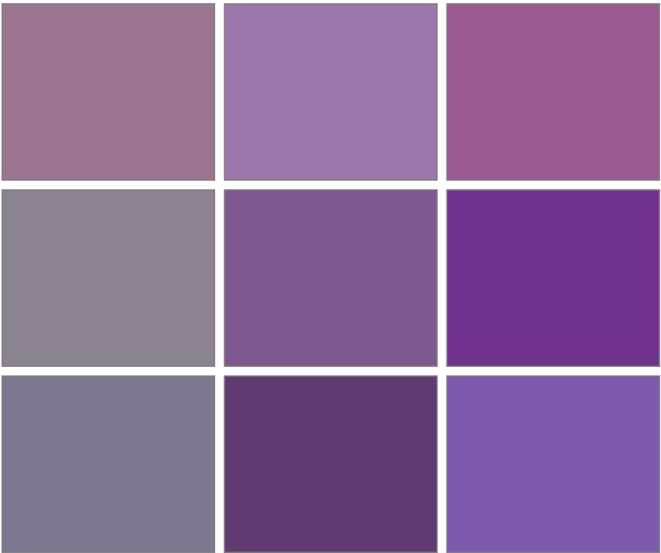
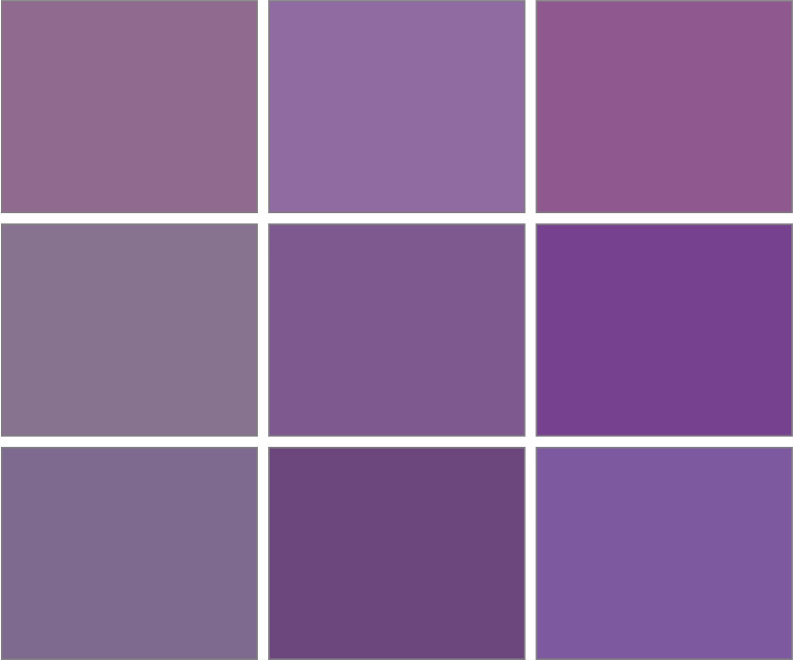
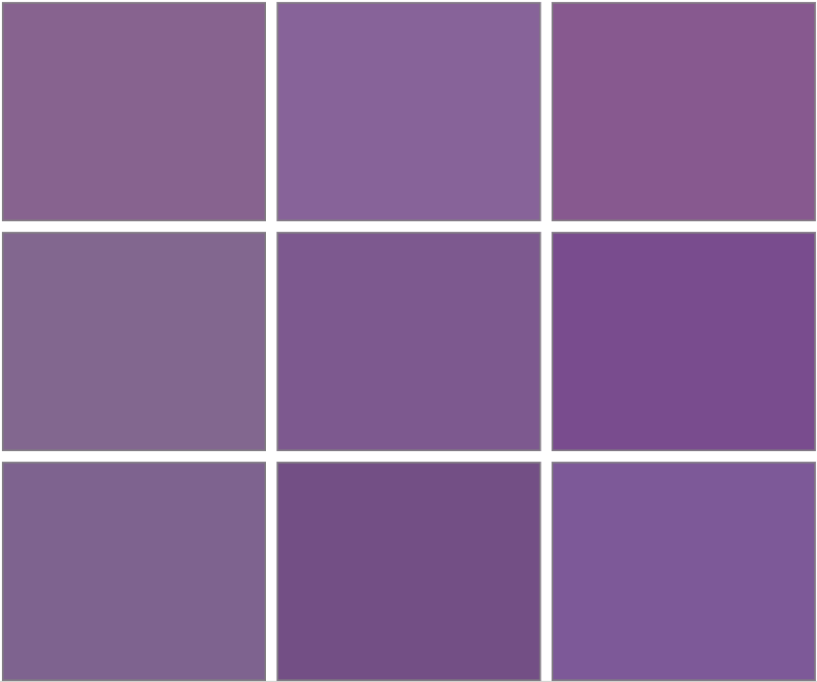



STUDY DESIGN
What colour do I associate with this emotion term?
INTEREST
AMUSEMENT
PRIDE
JOY
PLEASURE
CONTENTEMENT
ADMIRATION
LOVE
RELIEF
COMPASSION
ANGER
HATE
CONTEMPT
DISGUST
FEAR
DISAPPOINTMENT
SHAME
REGRET
GUILT
SADNESS
https://www2.unil.ch/onlinepsylab/ColourPicker/html/colorpicker.html; Epicoco et al. (in revision)
Notes:
Design a little bit tweaked than what we did before, 1st to facilitate comprehension and time with smaller children
Presented with 20 emotions terms in random order → for children, we made sure they understood the emotion concept, by presenting them with controlled examples when they did not know the term
Asked the question → what colour would you associate with the presented emotion term
Used the colour picker to choose what colour they associate with the emotion term:
Participants are presented with 9 squares of different colours.
1st, they click on the square that is closer to the colour they have in mind (here, purple)
Then, this patch is moved as the centre patch of the next screen. It is the reference colour
2nd they now have around the centre patch, 8 variations of the chosen colour. It varies on the axes of lightness and chroma, but also, we can add more red, blue, yellow and green to our colour to changes it’s hue. Here, our participant clicked on the upper middle patch, changing it’s lightness (clearer)
Now, this new patch is the centre patch as the reference colour. Our participant is happy with it, so they clicked on it, until it appears on its own, meaning it is the final choice
They could start over, if they made a mistake or were not happy with their choice
Thus, we had both RGB and LCH values spited out from the colour picker and here, we are using LCH values. The colour picker was self-calibrated by the experimenter. We used the same office room, away from any external light to reproduce as best as possible lab condition

Slide 8
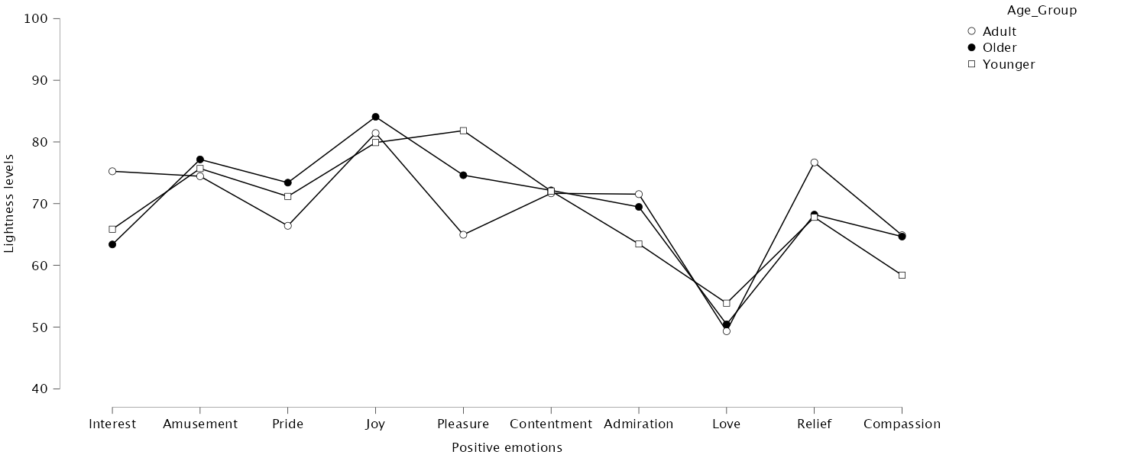
RESULTS: LIGHTNESS
F(2,119) = 58.3, p = .903
Notes:
Then, following what the literature tells us (i.e, we know positive and negative emotions are differently associated), we split our dataset in 2:
10 Positive emotions (PE)
10 Negative emotions (NE)
Positive emotions and lightness:
No statistically significant difference! Meaning, whether their age, our participants agreed on the same lightness for all PE together
However, within-subject, so within the emotions, we did find some differences:
Joy is the lighter colour
Love is relatively darker than the others, could come from the over-usage of red in younger children

Slide 9
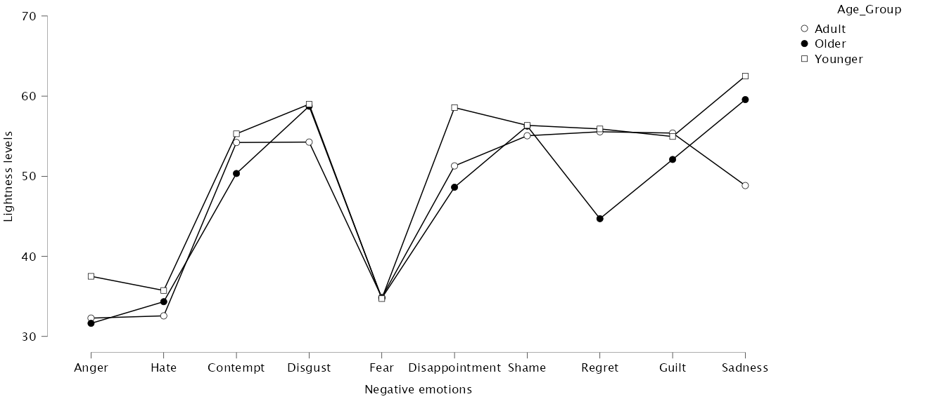
RESULTS: LIGHTNESS
F(2,119) = 1.93, p = .149
Notes:
Negative emotions and lightness:
No statistically significant difference! Meaning, whether their age, our participants agreed on the same lightness for all NE together
No within-subject differences were found

Slide 10
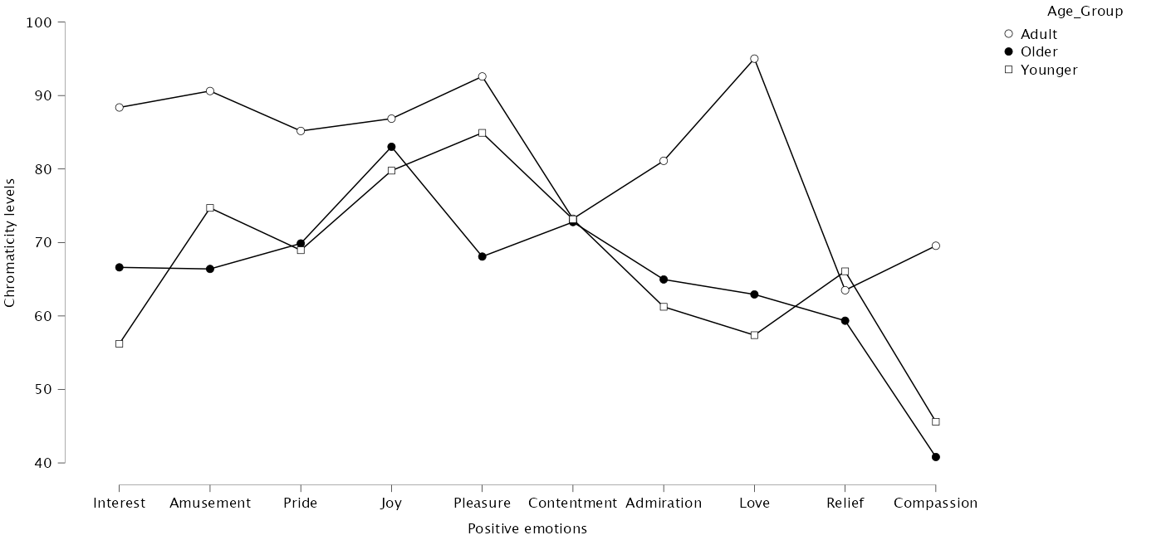
RESULTS: CHROMA
F(2,119) = 27.8, p < .001
Notes:
Positive emotions and chroma:
statistically different! Meaning, participants did not agree on the chromaticity of colour for PE. Indeed, the adult group chose more chromatic colours for PE together than the other two.
Within-subject, we did find some differences too:
Chromaticity levels for love were stat. different for all the groups
Older children chose less chromatic colours than younger children and adults for pleasure
So here, it seems either emotion comprehension or the concept of a bright/dull colour as an impact on their colour choices

Slide 11
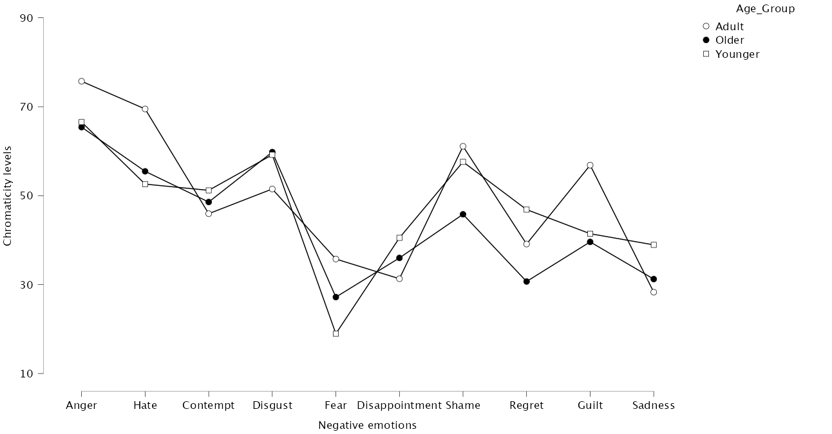
RESULTS: CHROMA
F(2,119) = 2.13, p = .124
Notes:
Negative emotions and chroma:
No statistically significant difference! Meaning, whether their age, our participants agreed on the same chroma for all NE together
No within-subject differences were found

Slide 12
RESULTS: HUE
χ²(14) = 119.92, p < .001
Notes:
Interesting to see how it moves with the ages; younger children are more likely to choose one type of colours than older and adults for Positive Emotions.
But, Statistically speaking:
- Yes, they did differ in their colour choices.
Younger = more red hues and fewer green-blues
Adult = selecting fewer yellow hues
Nothing significantly different when compared to the two other groups

Slide 13
RESULTS: HUE
χ²(14) = 175.21, p < .001
Notes:
Here, what is interesting to see, is that younger children are more scattered throughout the hue choices, they do not bundle up in a few categories like they did for PE. And it elevates with the ages.
But, Statistically speaking:
- Yes, they did differ in their colour choices.
Adults = more purple hues and less yellow-green and green hues than both children groups

Slide 14

TAKE-HOME MESSAGE
No significant impact of lightness:
Dark/light concepts already understood for negative/positive emotions
Chroma and Hue underlie developmental changes in colour-emotion pairings:
Especially for positive emotions
Impact the conceptual construction of the presented pairings (perception still has a role to play)
Might emerge with the acquisition of cultural and societal knowledge (i.e., vice-versa movie)
Jonauskaite et al. (2020a); Zentner (2001)
Notes:
Lightness seems to be a well-understood concept already at 6 years old. Studies on younger children indeed found that at 3 years old, the concept of what is a dark colour and what is a light colour is acquired so not surprising here.
We conclude that hue and chroma underlie developmental changes in colour-emotion pairings, especially for the positive ones, and by inference their conceptual construction. It could means that positive emotions are less likely understood by small children, than negative emotions
It could also mean that, these might emerge with the acquisition of cultural and societal knowledge (i.e., red and love metaphor).

Slide 15
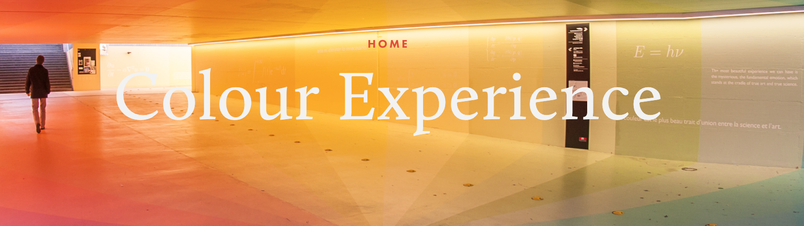





All our amazing research assistants!
Giulia Spagnulo
Nizar Michaud
Marie-Lou Mailler
& more than a 100 international collaborators!
Prof. Christine Mohr
Dr. Domicele Jonauskaite
Notes:
End message, thank you and questions

